Slide 1

Learning Objective
I will be able to determine the equation of a parallel and perpendicular line
Enter quietly, please be ready with the following on your desk:
Whiteboard
Whiteboard marker
Exercise Book
Pencil, pen, ruler and red pen
Diary
Calculator (Scientific and ClassPad)
Device – charged or borrowed from Library before maths

Slide 2
Learning Objective
CFU
What will we learn today?
I will be able to determine the determine the equation of a parallel and perpendicular line
CFU
How will you know that you are successful?
Success Criteria
At the end of the lesson, I will be able to:
understand that parallel lines are lines with the same gradient;
be able to determine the equation of a parallel line to a given line, passing through a given point;
understand that two lines are perpendicular if the product of their gradients is -1; and
be able to determine the equation of a perpendicular line to a given line, passing through a given point.

Slide 3
Activating Prior Knowledge
Lines that are parallel to each other
will never intersect
have the same slope (gradient)

Slide 4

Concept Development
Parallel Lines
If two (or more) straight lines are parallel, they have the SAME gradient.
If two (or more) straight lines have the same gradient, they are PARALLEL.
$$m_{1}=m_{2}$$

Slide 5
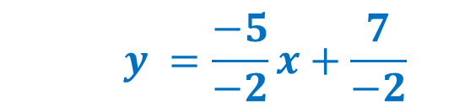





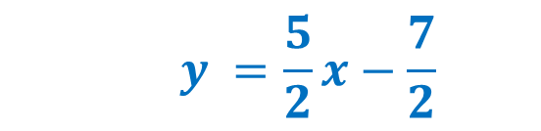
Skill Development
Show that the line with the equation $5x −2y=7$is parallel to the line with equation $2y=5x+11$
Step 1: rearrange both equations in to the form y=mx + b( slope-intercept form)
$$5x −2y=7$$
$$2y=5x+11$$
$$−2y =−5x+7$$
$$y=\frac{5}{2}x+\frac{11}{2}$$
$$y =\frac{−5}{−2}x+\frac{7}{−2}$$
$$y =\frac{5}{2}x−\frac{7}{2}$$
Step 2: determine the gradient of each line: m₁ = $\frac{5}{2}$ and m₂ = $\frac{5}{2}$
Step 3: Because m₁ = m₂ the lines are parallel

Slide 6



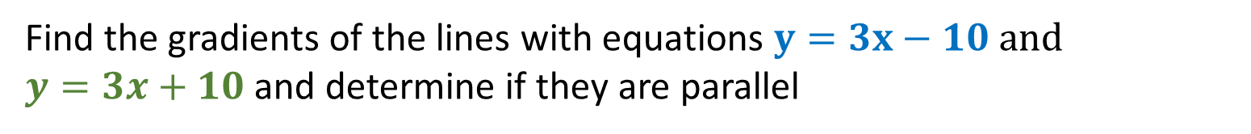



Skill Development
Find the gradients of the lines with equations $y=3x−10 and$
$y=3x+10$ and determine if they are parallel
Step 1: rearrange both equations in to the form y=mx + b( slope-intercept form)
$$y=3x −10$$
$$y=3x+10$$
$$m=3$$
$$m=3$$
$$gradient=3$$
$$gradient=3$$
Step 2: Because m₁= 3 and m₂ = 3 the two lines are parallel

Slide 7

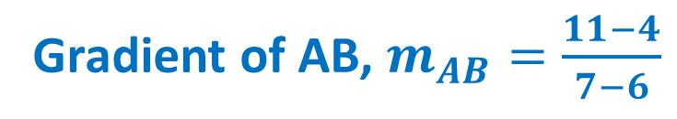

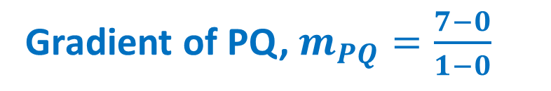


Guided Practice
Gradient of AB, $m_{AB}=\frac{11−4}{7−6}$
Gradient of PQ, $m_{PQ}=\frac{7−0}{1−0}$
$$m_{AB}=\frac{7}{1}$$
$$m_{PQ}=\frac{7}{1}$$
$$m_{AB}=7$$
$$m_{PQ}=7$$
Since $m_{AB}=m_{PQ}=7, ∴$ they are parallel

Slide 8
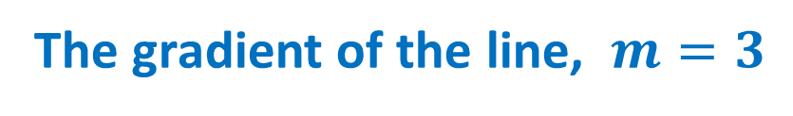

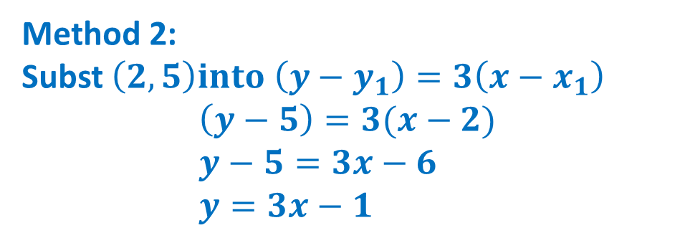
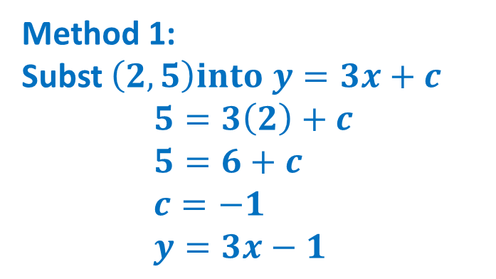

Guided Practice
Find the equation of the line that is parallel to $y = 3x − 1$ and goes through point (2, 5).
The gradient of the line, $m=3$
Equation of the line, $y=3x+c$
Method 1:
Subst $\left(2,5\right)into y=3x+c$ $$5=3\left(2\right)+c \\ 5=6+c \\ c=−1 \\ y=3x−1$$
Method 2:
Subst $\left(2,5\right)into \left(y−y_{1}\right)=3\left(x−x_{1}\right)$ $$\left(y−5\right)=3(x−2) \\ y−5=3x−6 \\ y=3x−1$$

Slide 9
Activating Prior Knowledge
Lines that are perpendicular to each other
intersect at 90°
have negative reciprocal slopes (gradients)
have -1 as the product (multiplying) of their slopes

Slide 10
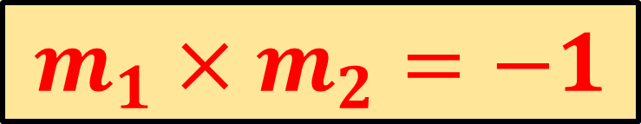

Perpendicular Lines
Concept Development
Two lines are perpendicular if the product of their gradients is -1.
If two line are perpendicular, then the product of the gradients is -1.
$$m_{1}=−\frac{1}{m_{2}}$$
$$m_{1}×m_{2}=−1$$
OR

Slide 11



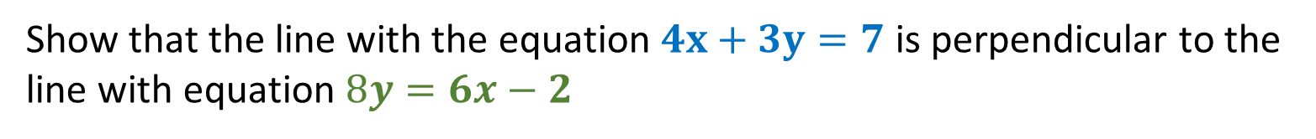



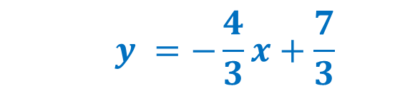
Guided Practice
Show that the line with the equation $4x+3y=7$is perpendicular to the line with equation $8y=6x−2$
Step 1: rearrange both equations in to the form y=mx + b( slope-intercept form)
$$4x+3y=7$$
$$8y=6x−2$$
$$3y =−4x+7$$
$$y=\frac{6}{8}x−\frac{2}{8}$$
$$y =\frac{−4}{3}x+\frac{7}{3}$$
$$y=\frac{3}{4}x−\frac{1}{4}$$
$$y =−\frac{4}{3}x+\frac{7}{3}$$
Step 2: determine the gradient of each line: m₁ = $−\frac{4}{3}$ and m₂ = $\frac{3}{4}$
Step 3: Because m₁ and m₂ are negative reciprocals, and m₁x m₂ = -1, the two lines are
perpendicular

Slide 12
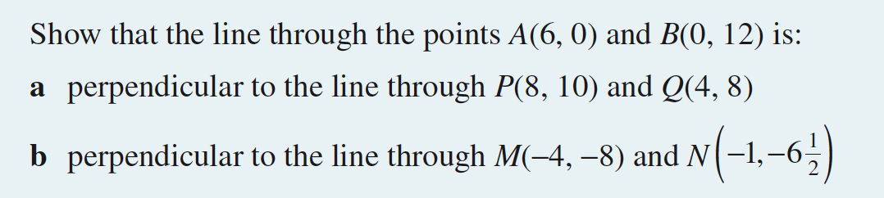



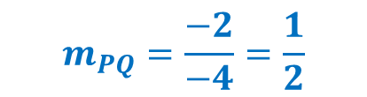

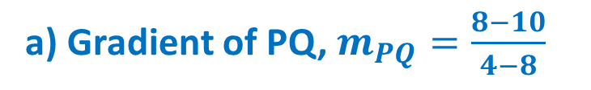
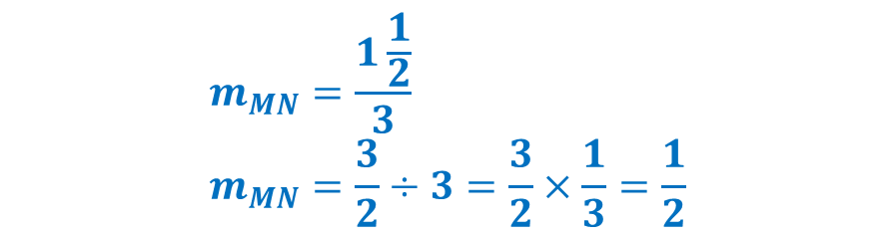




Guided Practice
Gradient of AB, $m_{AB}=\frac{12−0}{0−6}$
$$m_{AB}=\frac{12}{−6}$$
b) Gradient of MN, $m_{MN}=\frac{−6\frac{1}{2}−(−8)}{−1−(−4)}$
$$m_{AB}=−2$$
$$m_{MN}=\frac{1\frac{1}{2}}{3} \\ m_{MN}=\frac{3}{2}÷3=\frac{3}{2}×\frac{1}{3}=\frac{1}{2}$$
a) Gradient of PQ, $m_{PQ}=\frac{8−10}{4−8}$
$$m_{PQ}=\frac{−2}{−4}=\frac{1}{2}$$
$${m_{AB}×m}_{PQ}=−2×\frac{1}{2}=−1$$
$${m_{AB}×m}_{MN}=−2×\frac{1}{2}=−1$$
$∴AB$ is perpendicular to $PQ$
$∴AB$ is perpendicular to $MN$

Slide 13

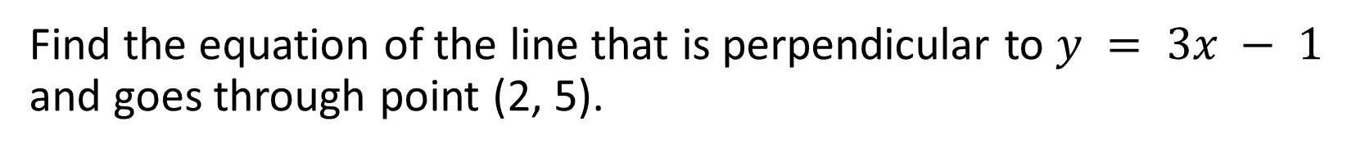
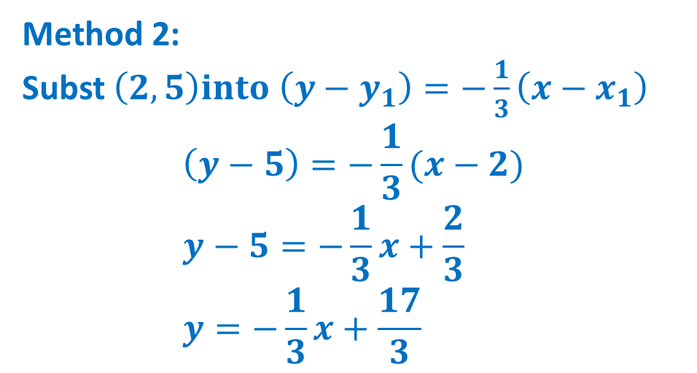
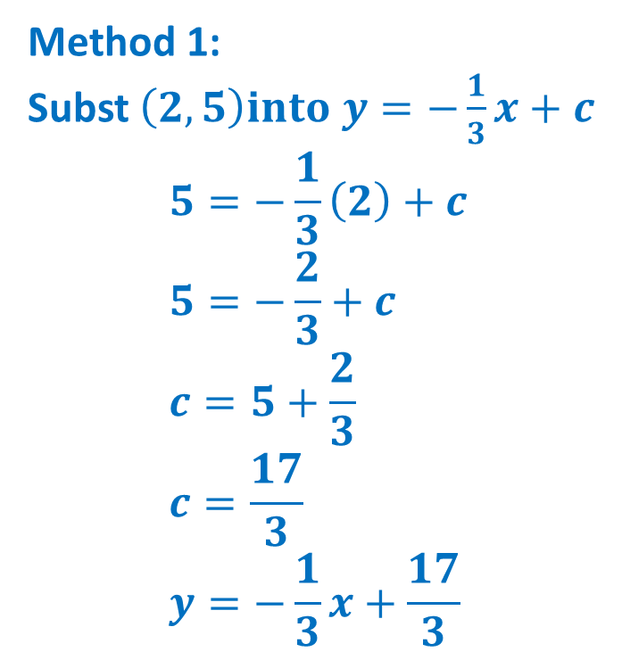
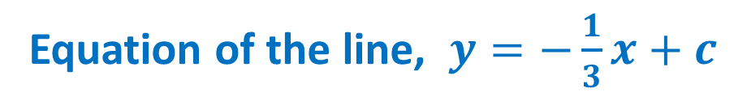
Guided Practice
Find the equation of the line that is perpendicular to $y = 3x − 1$ and goes through point (2, 5).
The gradient of the line, $m=−\frac{1}{3}$
Equation of the line, $y=−\frac{1}{3}x+c$
Method 1:
Subst $\left(2,5\right)into y=−\frac{1}{3}x+c$ $$5=−\frac{1}{3}\left(2\right)+c \\ 5=−\frac{2}{3}+c \\ c=5+\frac{2}{3} \\ c=\frac{17}{3} \\ y=−\frac{1}{3}x+\frac{17}{3}$$
Method 2:
Subst $\left(2,5\right)into \left(y−y_{1}\right)=−\frac{1}{3}\left(x−x_{1}\right)$ $$\left(y−5\right)=−\frac{1}{3}(x−2) \\ y−5=−\frac{1}{3}x+\frac{2}{3} \\ y=−\frac{1}{3}x+\frac{17}{3}$$

Slide 14

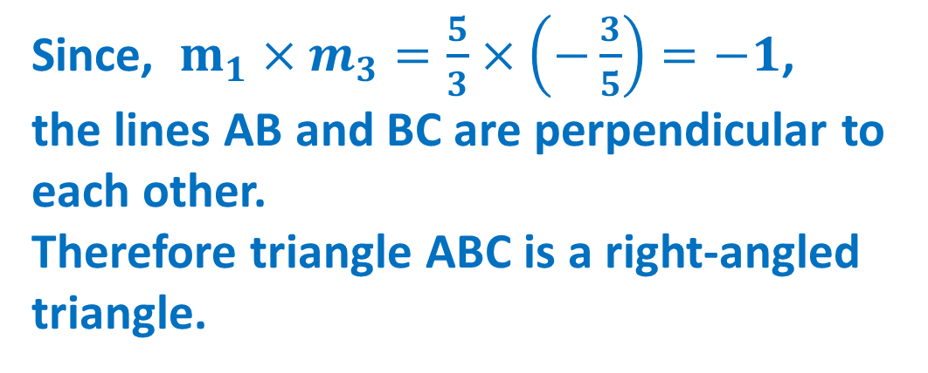
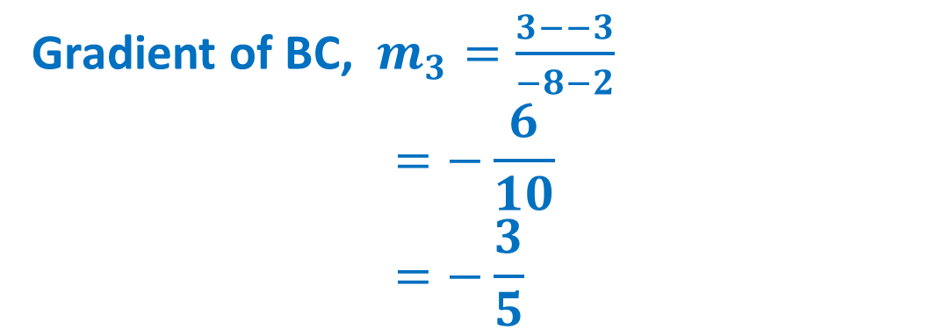

Guided Practice
Gradient of AB, $m_{1}=\frac{−3−2}{2−5}$ $$=\frac{5}{3}$$
Since, $m_{1}×m_{3}=\frac{5}{3}×\left(−\frac{3}{5}\right)=−1$, the lines AB and BC are perpendicular to each other.
Therefore triangle ABC is a right-angled triangle.
Gradient of AC, $m_{2}=\frac{3−2}{−8−5}$ $$=−\frac{1}{−13}$$
Gradient of BC, $m_{3}=\frac{3−−3}{−8−2}$ $$=−\frac{6}{10} \\ =−\frac{3}{5}$$

Slide 15
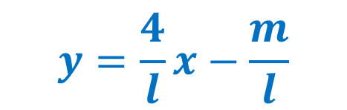




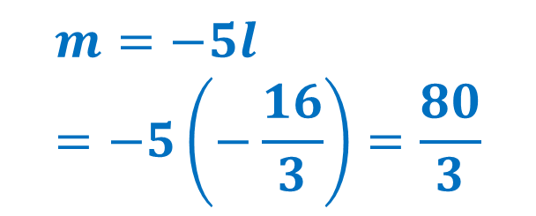

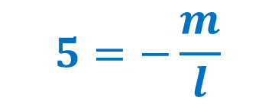

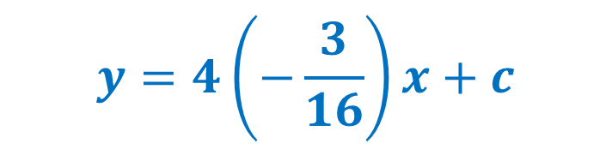


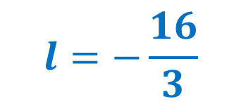

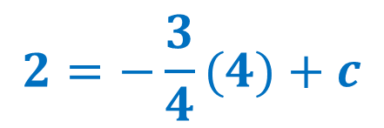
Guided Practice
$$4x−3y=10$$
$$4x−ly=m$$
$$3y=4x−10$$
$$ly=4x−m$$
$$y=\frac{4}{l}x−\frac{m}{l}$$
$$y=\frac{4}{3}x−\frac{10}{3}$$
Since the lines are perpendicular, $\frac{4}{l}=−\frac{3}{4}$
$$l=−\frac{16}{3}$$
Substitute $(4,2)$ into equation to solve for c
$$2=−\frac{3}{4}(4)+c$$
$$5=−\frac{m}{l}$$
$$y=4\left(−\frac{3}{16}\right)x+c$$
$$c=5$$
$$m=−5l \\ =−5\left(−\frac{16}{3}\right)=\frac{80}{3}$$
$$y=−\frac{3}{4}x+c$$

Slide 16
Independent Practice
Complete Cambridge Ex 2E

